Slide 1
Integer Arithmetic
Fazeelat Mazhar

Slide 2
Book Chapter
“Computer Organization and Architecture”
Author “William Stallings”
8th Edition
Chapter 9
Section 9.1
Section 9.2
Section 9.3

Slide 3
Arithmetic and Logic Unit (ALU)
Performs the calculations
Everything else in the computer is there to serve this unit
Handles integers
May handle floating point numbers
May have a separate FPU

Slide 4
ALU Inputs and Outputs
ALU
Control Unit
Flags
Registers
Registers

Slide 5
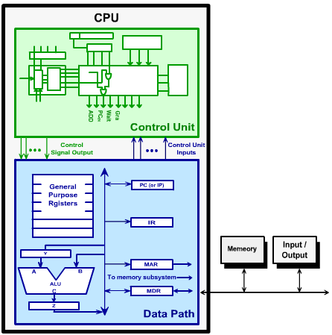
Computer System and place of ALU

Slide 6
Integer Representation
Positive integers are stored in computer in binary format
e.g. 43 = 00101011
Minus sign and period cannot be stored in binary format
Signed numbers can be represented by
Sign-Magnitude Representation
Twos Complement Representation

Slide 7
Sign-Magnitude Representation
MSB represents the sign of the integer
0 for positive integers
1 for negative integers
Remaining bits represent the magnitude of the number
Draw backs,
both sign and magnitude should be considered during addition subtraction.
Two representations of 0
1001 1101 → MSB = 1 so number is negative
001 1101 = 2⁴+2³+2²+2⁰ = 16+8+4+1 = 29
Since MSB = 1, so 1001 1101 represents –29

Slide 8
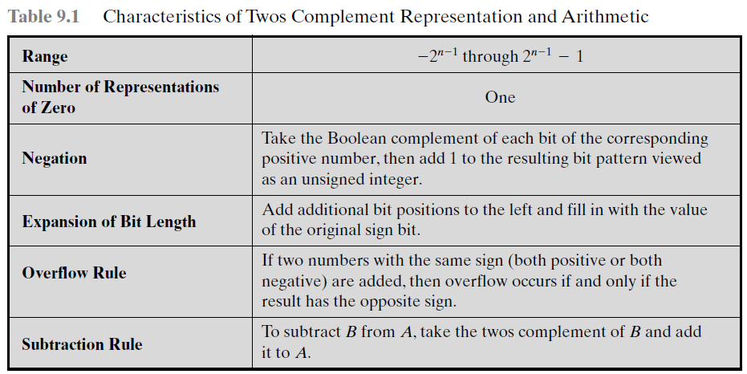
Two’s Complement Representation

Slide 9
Addition and Subtraction
Normal binary addition
Monitor sign bit for overflow
For subtraction, take twos complement of the subtrahend and add to other operand
We can perform subtraction by using the addition operation.

Slide 10
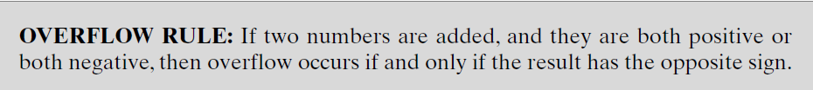
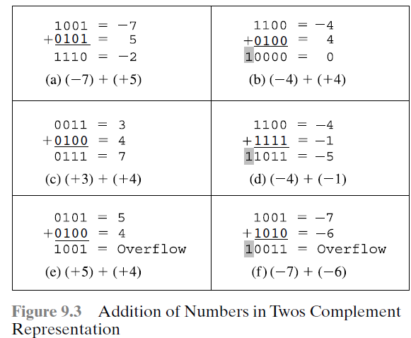

Slide 11
Block Diagram for Adder/Subtractor
B Register
A Register
Complementer
SW
OF
Adder

Slide 12
Multiplication
Complex operation as compared to addition/subtraction
In simple paper and pencil approach
Work out partial product for each digit
Take care of place of values in partial product
Add partial products to get the final product

Slide 13
Unsigned Binary Multiplication (1/3)
1 0 1 1
X 1 1 0 1
1 0 1 1
0 0 0 0
1 0 1 1
1 0 1 1
1 0 0 0 1 1 1 1
Multiplicand (11)
Multiplier (13)
Partial Product
Product (143)

Slide 14
Flowchart for Unsigned Binary Mul.
START
C, A ← 0
M ← Multiplicand
Q ← Multiplier
Count ← n
No
Yes
Q₀ = 1?
C, A ← A + M
Shift right C, A, Q
Count ← Count-1
No
Count=0
Yes
END

Slide 15
Unsigned Binary Multiplication (2/3)
Multiplicand
M_{n-1} |  | M₀
n-Bit Adder
Add
Shift and Add
Control Logic
Shift right
C
A_{n-1} |  | A₀
Q_{n-1} |  | Q₀
Multiplier

Slide 16
Unsigned Binary Multiplication (3/3)
C | A | Q | M
0 | 0000 | 1101 | 1011 | Initial Values
0 | 1011 | 1101 | 1011 | Add | First Cycle
0 | 0101 | 1110 | 1011 | Shift
0 | 0010 | 1111 | 1011 | Shift | Second Cycle
0 | 1101 | 1111 | 1011 | Add | Third Cycle
0 | 0110 | 1111 | 1011 | Shift
1 | 0001 | 1111 | 1011 | Add | Fourth Cycle
0 | 1000 | 1111 | 1011 | Shift

Slide 17
Multiply Negative Numbers
Three possibilities to multiply negative numbers
Solution 1
Convert to positive if required
Multiply as previous slides like paper and pencil method
If signs of original numbers were different, negate answer
Solution 2
Twos complement multiplication
Solution 3
Booth’s algorithm

Slide 18
Two’s Complement Multiplication
In binary multiplication, multiplicand is multiplied either by 1 or 0
Multiplication of a binary number by 2^{n} means shifting the multiplicand n bits left
Partial product is written as a 2n-bit number
Sign-bit of partial product is extended till end
Will not work if multiplier is negative

Slide 19
Two’s Complement Multiplication
1 0 1 1
X 0 1 0 1
1 1 1 1 1 0 1 1
0 0 0 0 0 0 0 0
1 1 1 0 1 1 0 0
1 1 1 0 0 1 1 1
Multiplicand (not 11 but –5)
Multiplier (+5)
Partial Product
Product (not 55 but -25)

Slide 20
Booth’s Algorithm (1/3)
Works with any combination of positive and negative numbers
Efficient as compared to previously discussed methods
Blocks of 1s and 0s are skipped over and just shifting is performed

Slide 21
Flowchart of Booth’s Algorithm(2/3)
START
A ← 0, Q₋₁ ← 0
M ← Multiplicand
Q ← Multiplier
Count ← n
Q₀=1
Q₋₁=0
Q₀ Q₋₁
Q₀=0
Q₋₁=1
A ← A – M
Q₀=Q₋₁
A ← A + M
Arithmetic Shift right A, Q, Q₋₁
Count ← Count – 1
No
Count=0?
Yes
END

Slide 22
Booth’s Algorithm (3/3)
Multiplicand
M_{n-1} |  | M₀
n-Bit Adder/ Subtractor
Add
Shift, Add and Subtract
Control Logic
Subtract
Shift Arithmetic Right
A_{n-1} |  | A₀
Q_{n-1} |  | Q₀
Q₋₁
Multiplier

Slide 23
Booth’s Algorithm Example
A | Q | Q₋₁ | M
0000 | 1101 | 0 | 1011 | Initial Values
0101 | 1101 | 0 | 1011 | A = A–M | First Cycle
0010 | 1110 | 1 | 1011 | SAR
1101 | 1110 | 1 | 1011 | A = A+M | Second Cycle
1110 | 1111 | 0 | 1011 | SAR
0011 | 1111 | 0 | 1011 | A = A–M | Third Cycle
0001 | 1111 | 1 | 1011 | SAR
0001 | 1111 | 1 | 1011 | Do Nothing | Fourth Cycle
0000 | 1111 | 1 | 1011 | SAR

Slide 24
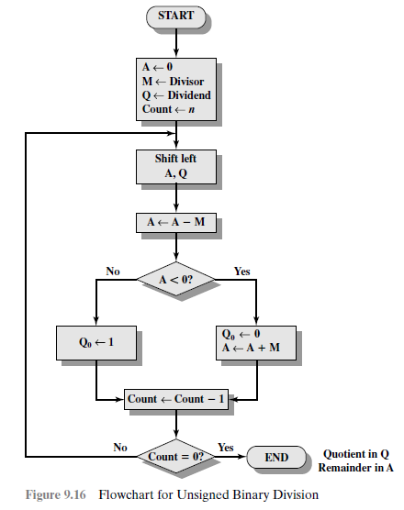
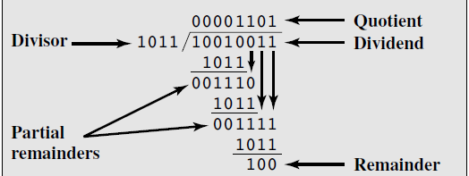
Division

